Slide 1
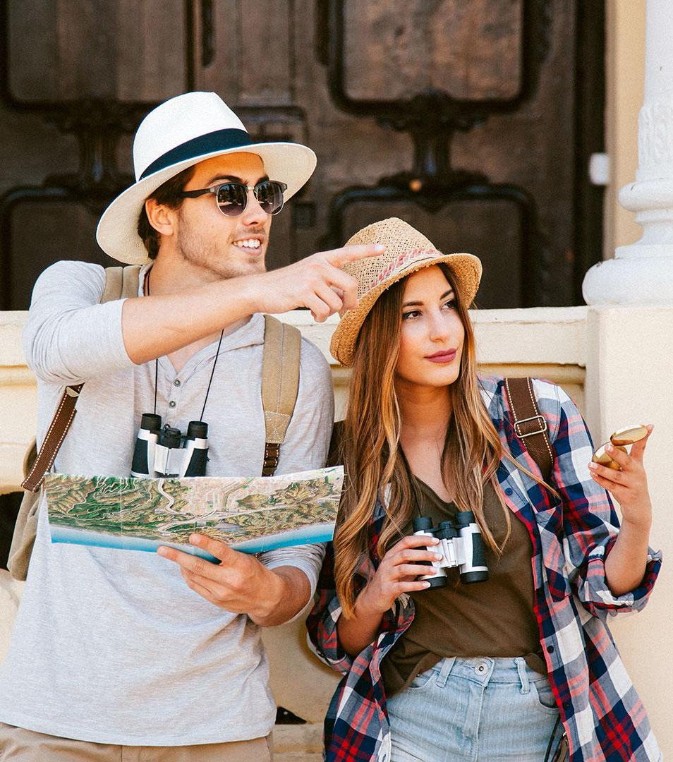
Machine Learning Capstone Project on :
Hotel Reservations
Christopher Robinson (PGDA Batch 28)

Slide 2
Objective and Problem Statement
Problem statement: Significant volume of hotel reservations are called of citing cancellation or no shows mainly due to change of plans and scheduling conflicts. This is done quite easily as cancellations are often free of charge or at a low cost . This results in a loss of revenue for the hotel
Objective : To be able to predict if the guest will honor the reservation or cancel it

Slide 3
Steps
Model Creation
Data Understanding
01
03
Data Preprocessing
02
04
Model Evaluations and tabulation
The Dataset consists of 18 columns with 36275 entries.
Target Variable is Booking status (Categorical)
Modelling represents training Machine learning algorithms to predict the labels from the feature. The used classification algorithm, to train and test the models are Logistic Regression, Ada-boost, KNN, Support vector, Naïve-Bayes, Random Forest feature importance.
Handling the missing values, Outlier Detection, Outlier Capping, Chi-square test to check the relationship with the Target variable. Label-Encoding and Data standardisation using MinMax scaler and VIF used to find Multi-collinearity, SMOTE.
Interpretation and Choosing the best model based on their scores

Slide 4
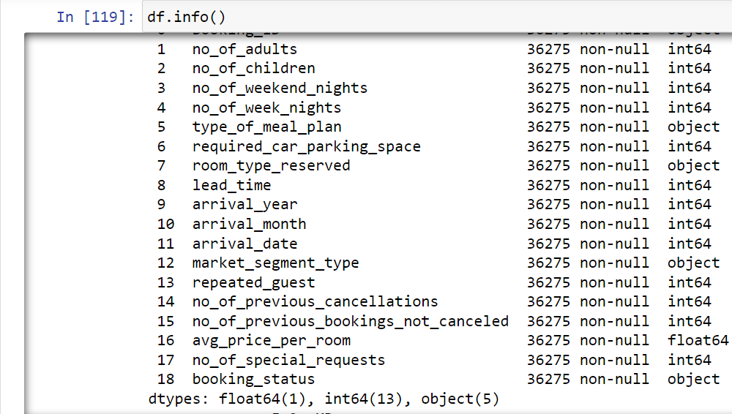
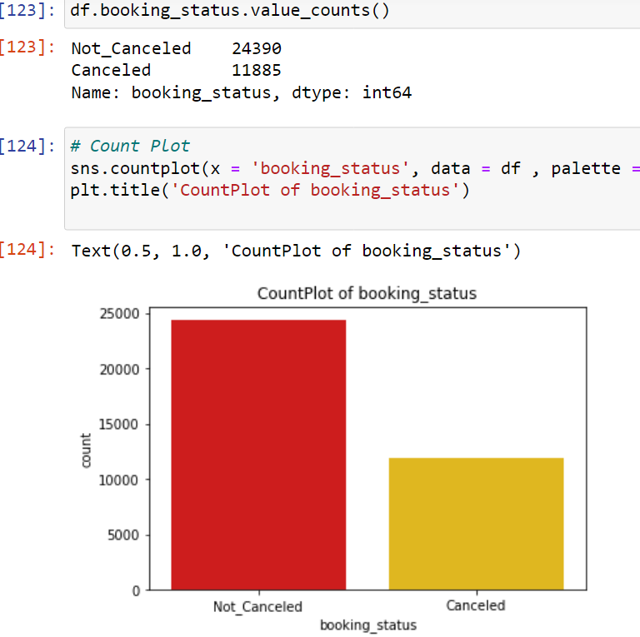
Target variable and Columns

Slide 5
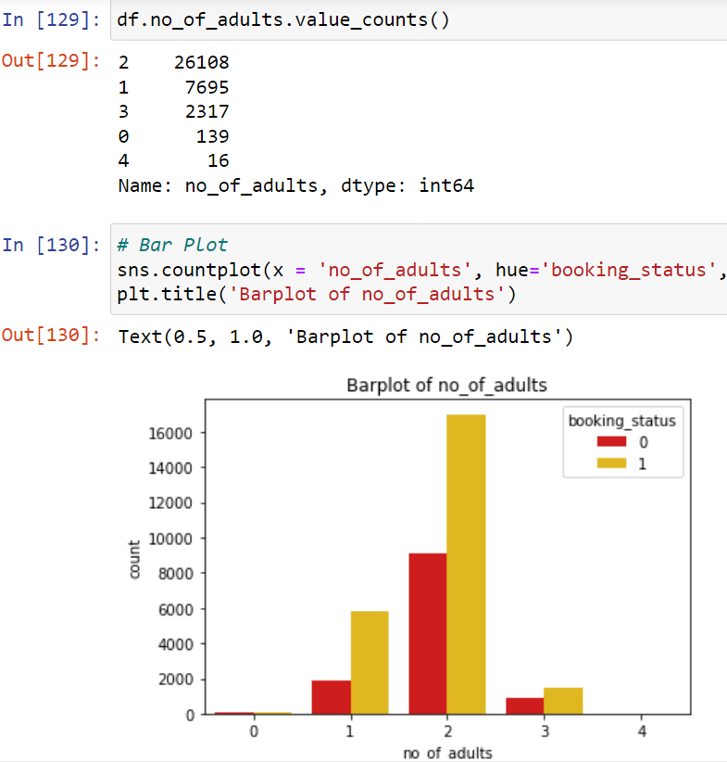
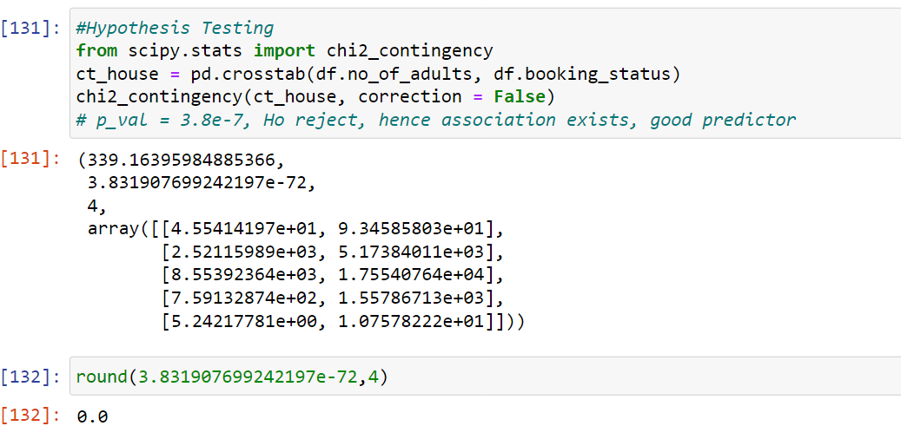
Example of how a single independent var is treated with the Target variable

Slide 6
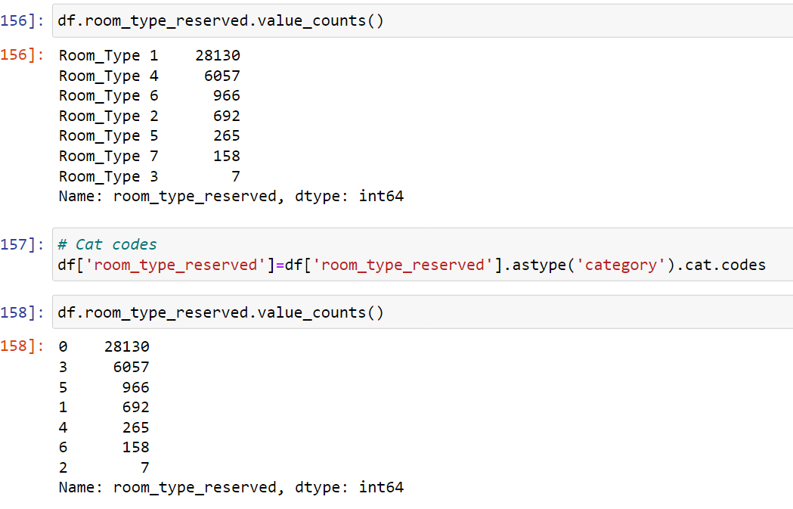
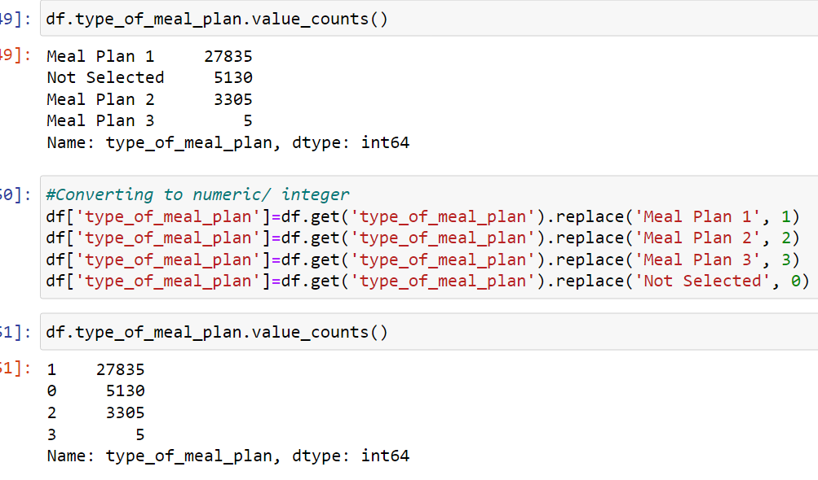
Label-Encoding and replacing manually is done for ordinal data

Slide 7
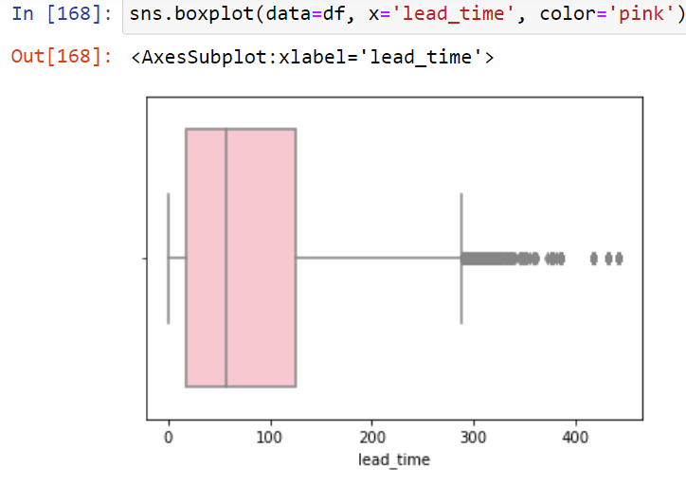
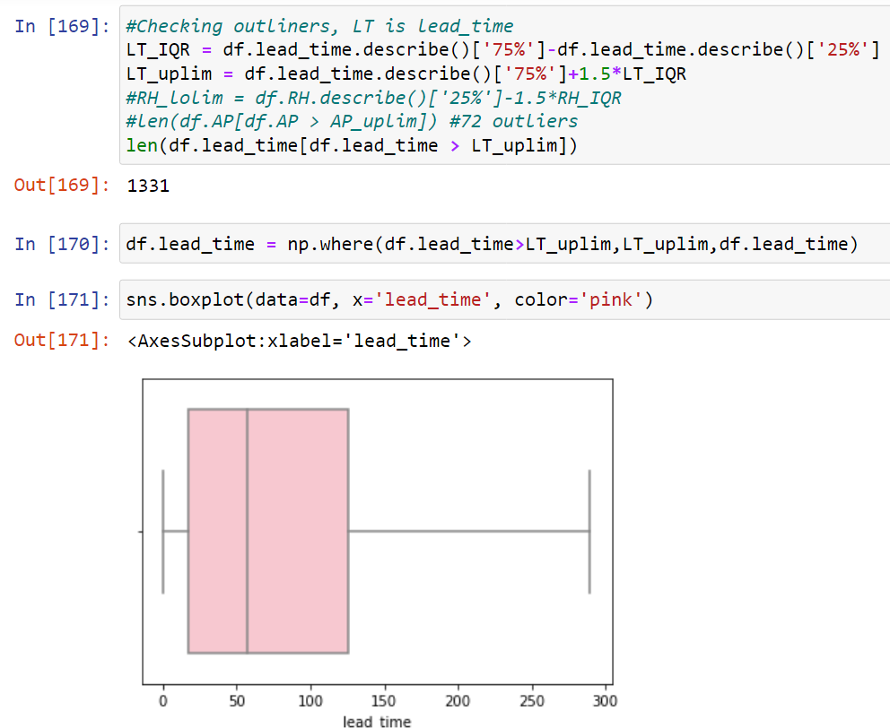
Example of Outlier detection and outlier capping

Slide 8
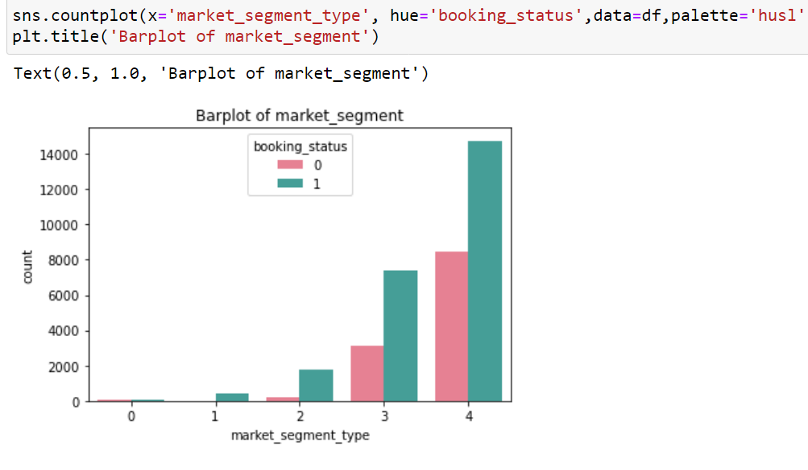
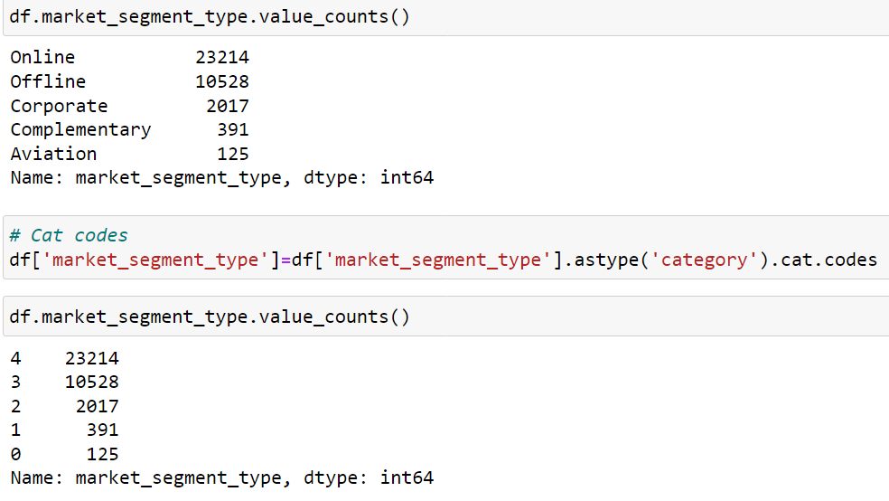
Market Segments contributing for hotel reservations

Slide 9
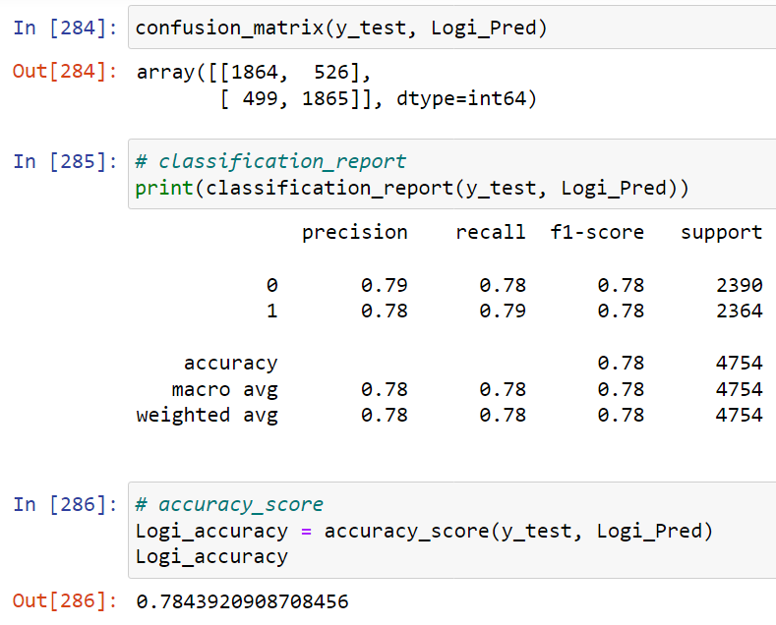
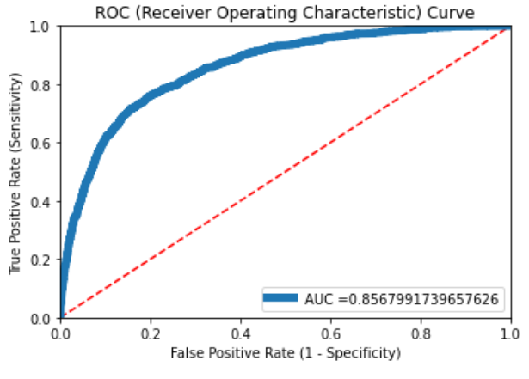
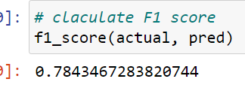
Example of Logistic regression model performance scores using Confusion matrix, F1 score and ROC curve.

Slide 10
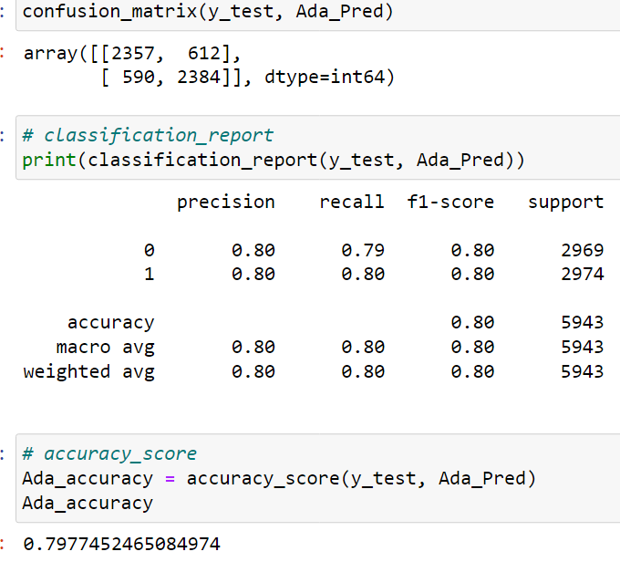
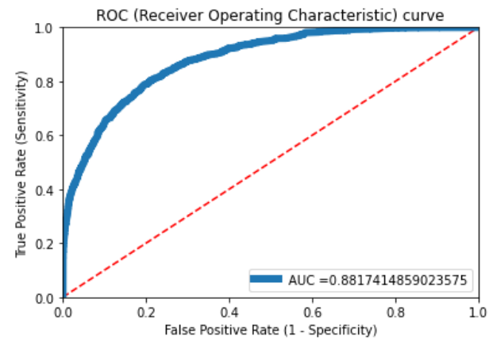
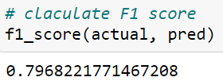
Ada- Boost

Slide 11
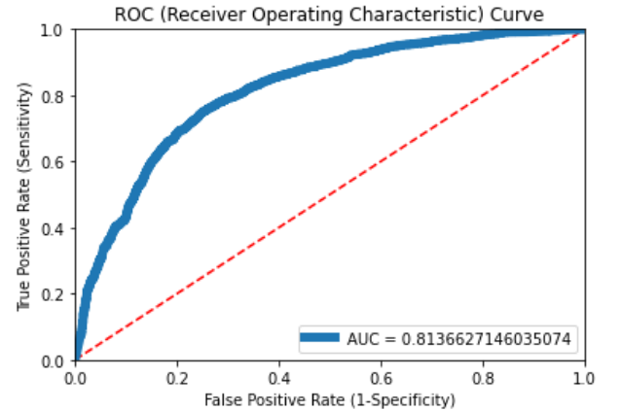
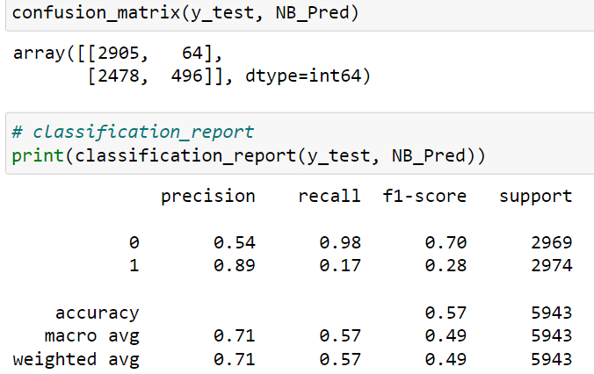
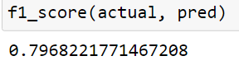
Naïve - Bayes

Slide 12
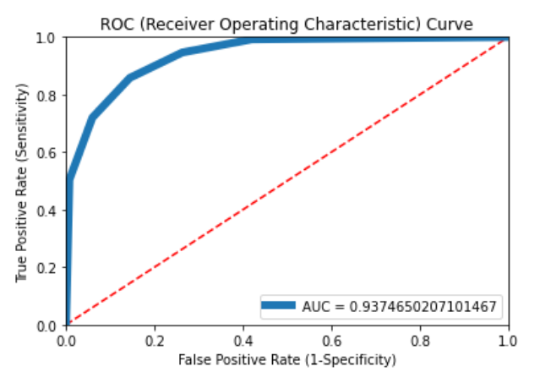
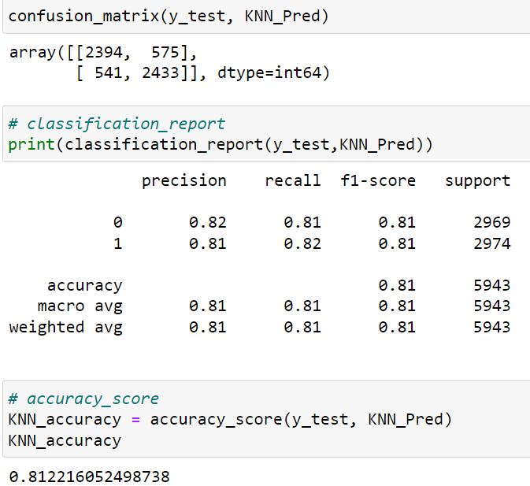
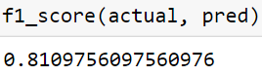
KNN

Slide 13
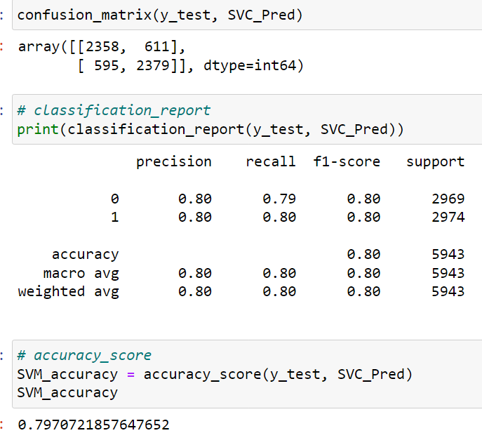
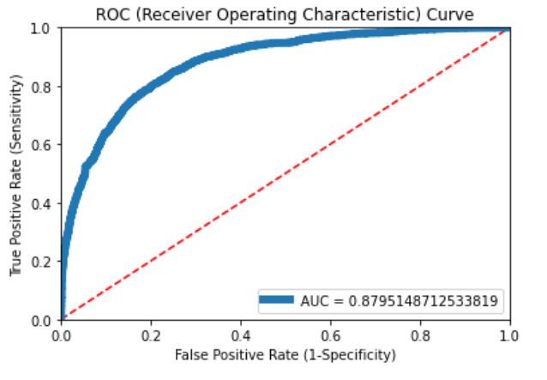
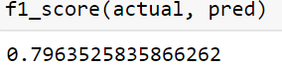
Support Vector Machine

Slide 14
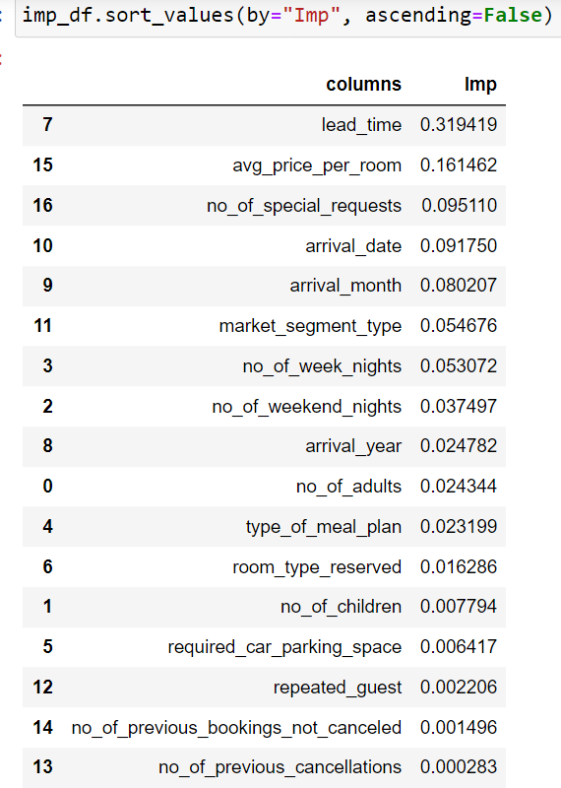
Random Forest Important Features

Slide 15
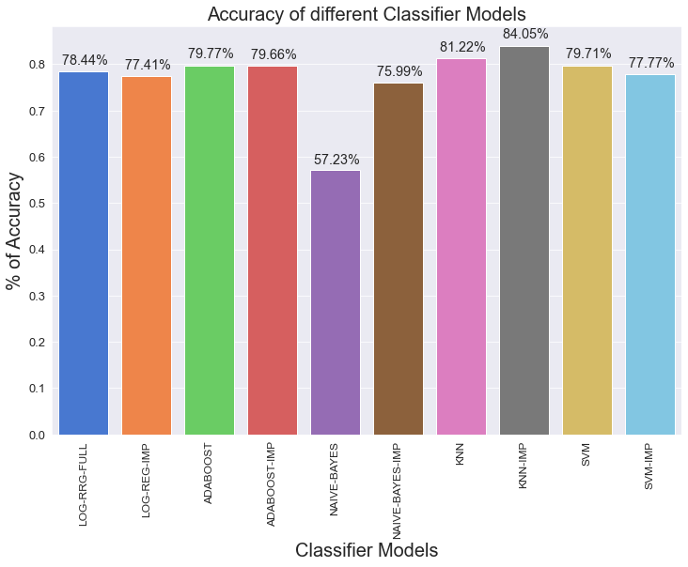
Comparison of various classification models used

Slide 16
From the Previous slide & Graph, We can see that KNN with important features obtained from random forest gave the best accuracy of (84.05%) So we can use the KNN for the Model Building. Note: All models evaluation matrix like confusion matrix, F1 score and ROC curve of important features isn’t added to these slides, only the overall graph is shown which is best for model building. They are available in the python scripts for reference.

Slide 17
Recommendations and Insights
Avoid cancellations by:
Delight Customer by offering room upgrade
Plan to minimize OTAs canncelations
Have a continuous connect with customer, Suggest a personalized itinerary
At the same or partial higher price, Offer an additional day stay for free or as a package
Not to promote book now and pay later, restrict free cancellations, have lesser commission for OTAs with higher cancellations.

Slide 18
Thank you!

